Slide 1
MODULE 6 :
Shell Scripting

Slide 2
Shell Scripting in Unix
A shell is a program constructed of shell commands ( $shell, $path, ls, pwd, mkdir… )
Shell is an environment for user interaction, but it is not a part of kernel.
Shell is just like as BAT files in MS-DOS.
By default, Bash shell is default shell for Linux.

Slide 3
Shell Scripting in Unix(contd.)
To find your default shell in Unix OS, type the following in your terminal
❯ echo $SHELL
/bin/bash
To check what are the different types of shells supported, cat the contents of /etc/shells file.

Slide 4
Structure of a Script
#!/bin/bash – It defines which shell will be used to run the script.
#comments – Comments can be made by using # symbol in a script.
chmod +x script.sh – To tell the linux that file is executable.
./script.sh – To execute the script.

Slide 5
Variables in Shell Scripts
In shell scripts you can use variables, they are just symbolic name to a chunk of memory to which we assign values.
The variable assignment can be done with the following syntax
VARIABLE=value
Notes:
There should be no space around the “=” sign.
If there is a space, VARIABLE = value won’t work.
Also Variables are case-sensitive.
Consider the example below:
#!/bin/sh
MY_MESSAGE="Hello World"
echo $MY_MESSAGE

Slide 6
Variables in Shell Scripts(contd.)
Consider the example below:
#!/bin/sh
MY_MESSAGE="Hello World“
echo $MY_MESSAGE

Slide 7
Shell BUILTINS Commands
export : The export command marks an environment variable to be exported.
read : Use to get input (data from user) from keyboard and store (data) to variable.
exit : The exit command lets you quit the shell where it's run.
Other shell Builtins are…
alias, bg, break, cd, logout, popd, printf, pushd, pwd, read, ulimit, umask, help, history, set, help, history, if, jobs, kill, fg, exec, exit, continue, declare, shopt, source, wait, test, while and many more….

Slide 8
Shell Arithmetic
Syntax:
◦ expr op1 math-operator op2
Examples:
◦ $ expr 1 + 3
◦ $ expr 2 – 1
◦ $ expr 10 / 2
◦ $ expr 20 % 3
◦ $ expr 10 \* 3
◦ $ echo `expr 6 + 3`

Slide 9
Shell Metacharacters
Shell Metacharacters with files listing examples:
$ ls * will show all files
$ ls a* will show all files whose first name is starting with letter 'a'
$ ls *.c will show all files having extension .c
$ ls ut*.c will show files having extension .c but file name must begin with 'ut'
$ ls ? will show all files whose names are 1 character long
$ ls fo? shows files names which are 3 character long and begin with ‘fo’
$ ls [abc]* will show all files beginning with letters a,b,c

Slide 10
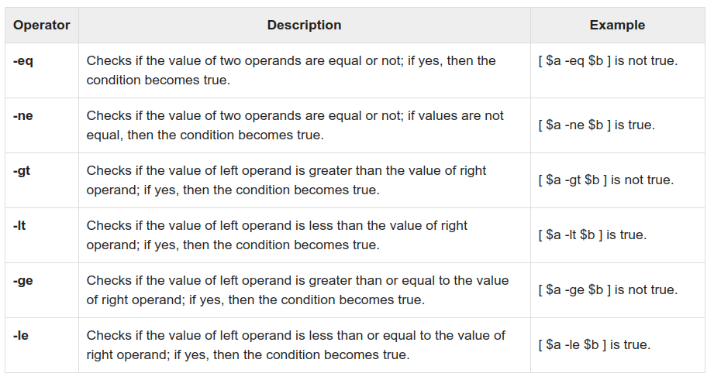
Relational Operators in Shell

Slide 11
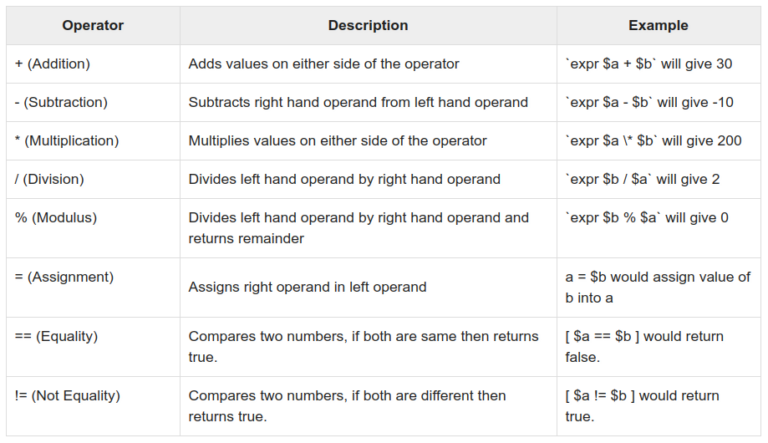
Arithmetic Operators in Shell

Slide 12
Decision Making Constructs in Shell
Unix Shell supports conditional statements which are used to perform different actions based on different conditions. We will now understand two decision-making statements here -
The if...else statement
The case...esac statement

Slide 13
Decision Making Constructs in Shell (contd.)
The if...else statements
If else statements are useful decision-making statements which can be used to select an option from a given set of options. Unix Shell supports following forms of if…else statement -
if...fi statement
if...else...fi statement
if...elif...else...fi statement

Slide 14
Decision Making Constructs in Shell (contd.)
if...else...fi example
$ vim myscript.sh
#!/bin/bash
read choice
if [ $choice -gt 0 ]; then
echo "$choice number is positive"
else
echo "$ choice number is negative"
fi

Slide 15
Nested if...else...fi example
$ vi nestedif.sh
#!/bin/bash
echo "1. Unix (Sun Os)"
echo "2. Linux (Red Hat)"
echo -n "Select your os choice [1 or 2]? "
read osch
if [ $osch -eq 1 ] ; then
echo "You Pick up Unix (Sun Os)"
else
if [ $osch -eq 2 ] ; then
echo "You Pick up Linux (Red Hat)"
else
echo "What you don't like Unix/Linux OS."
fi
fi

Slide 16
Decision Making Constructs in Shell (contd.)
The case...esac Statement
You can use multiple if...elif statements to perform a multiway branch. However, this is not always the best solution, especially when all of the branches depend on the value of a single variable.
Unix Shell supports case...esac statement which handles exactly this situation, and it does so more efficiently than repeated if...elif statements.
There is only one form of case...esac statement which has been described in detail here -
case...esac statement

Slide 17
Decision Making Constructs in Shell (contd.)
case….esac example
$ vi case-esac.sh
#!/bin/bash
echo "Enter Number in between 1 to 4"
read var
case $var in
1) echo “One”;;
2) echo “Two”;;
3) echo “Three”;;
4) echo “Four”;;
*) echo "Sorry, it is bigger than Four";;
esac

Slide 18
Loop Constructs in Shell
Bash supports the following loop constructs -
for loop
while loop
Note that in each and every loop:
First, the variable used in loop condition must be initialized, then execution of the loop begins.
A test (condition) is made at the beginning of each iteration.
The body of loop ends with a statement that modifies the value of the test (condition) variable.

Slide 19
Other Commands
sleep : It is used to delay for a fixed amount of time during the execution of any script. When the coder needs to pause the execution of any command for the particular purpose then this command is used with the particular time value. You can set the delay amount by seconds (s), minutes (m), hours (h) and days (d).
script : Make a typescript of a terminal session.
eval : execute arguments as a shell command.
exec : command in Linux is used to execute a command from the bash itself.

Slide 20
Thank You!

